Slide 1
Wines Around the World
Fabio Braga
Tuyet Nguyen
Irwin Mier
Anisha Nigam
Nicholas DiBiase
Magnus Doughan

Slide 2
Contents
For this project we use a combination of instructed class materials, including:
Python, Pandas, Matplotlib, Tableau, AWS, and Machine Learning (SciKit-Learn for Linear Regression, Random Forest Classifier, and Neural Networks with Keras)
Dataset consisting of over 150K records, still with over 92K after cleanup.
Use Machine Learning to answer the following key questions:
1) Is there a correlation between Points vs. Price
2) Can our model accurately predict wine rating based on description?
3) Is it possible to predict the price of a wine based on its description and variety?

Slide 3
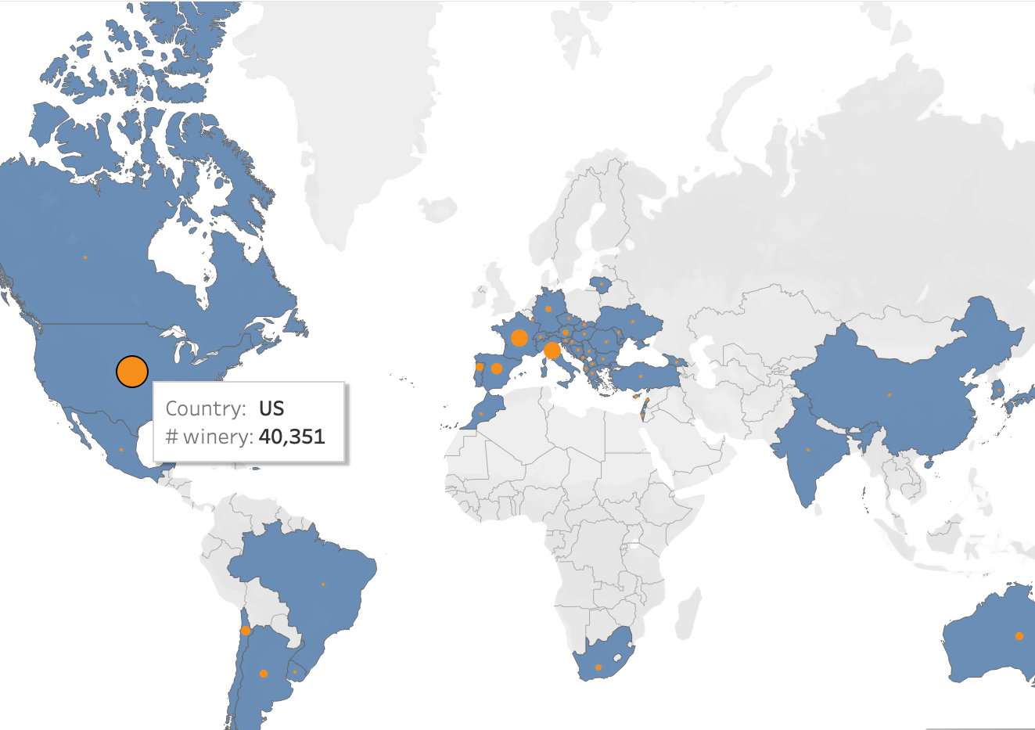
World Distribution

Slide 4
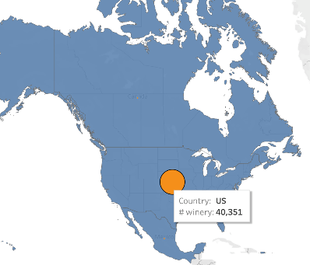
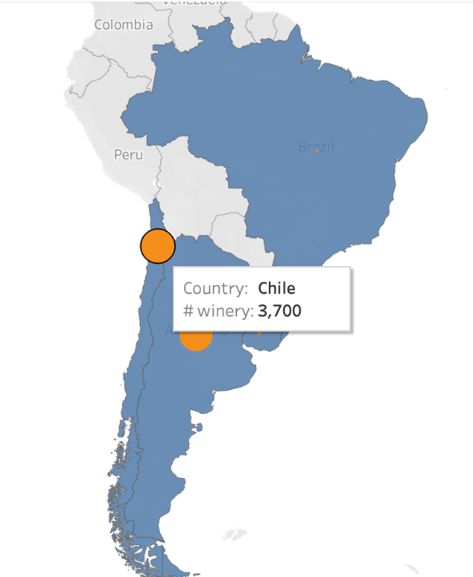
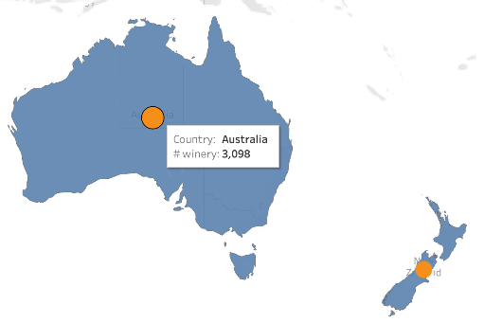
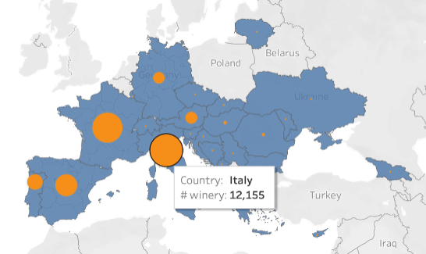
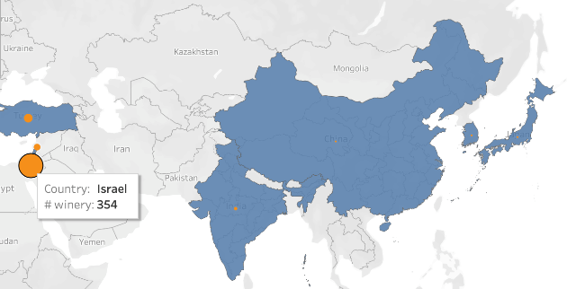
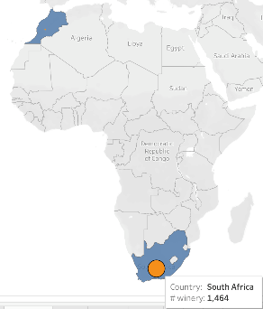
Top Countries per Region

Slide 5
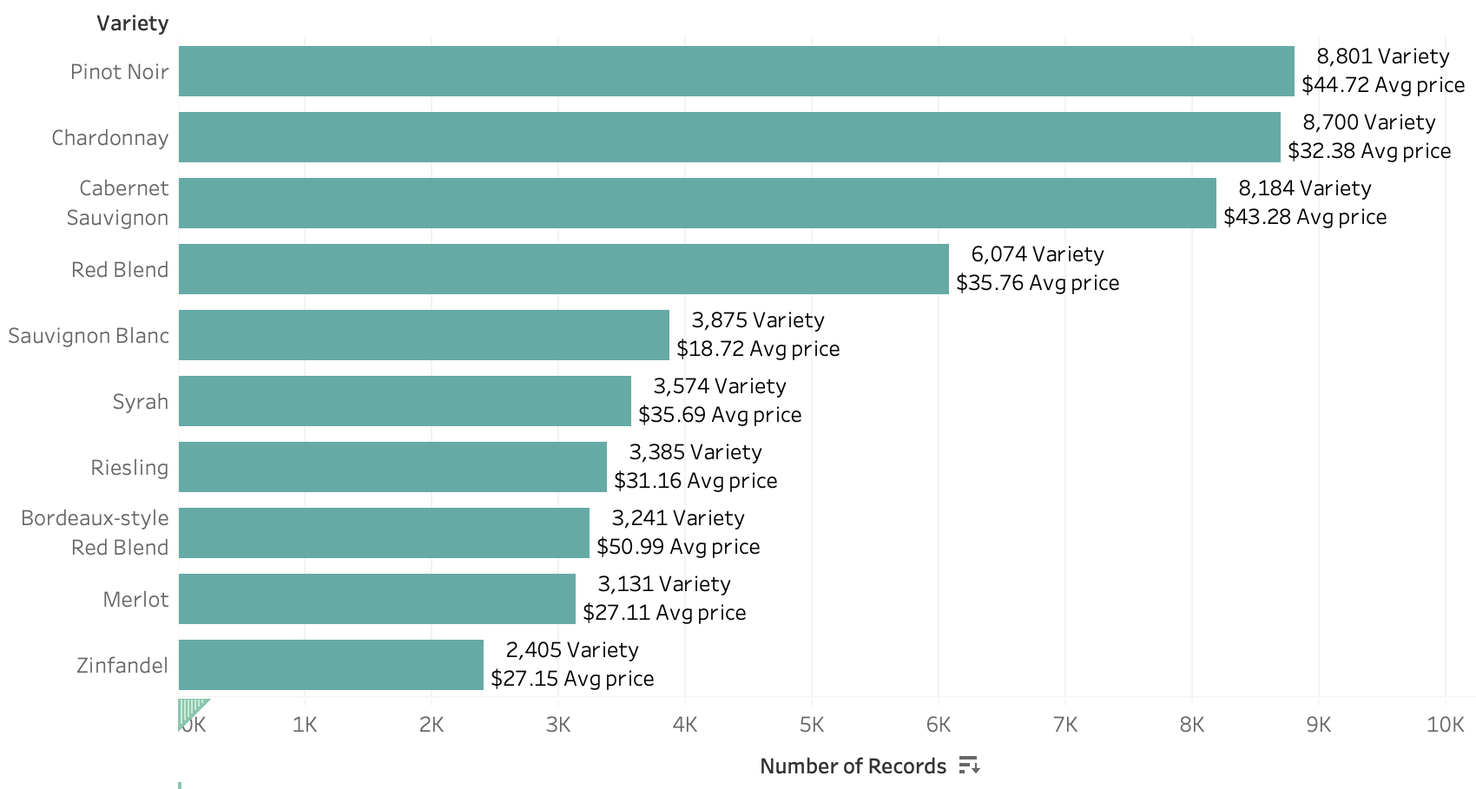
Top 10 World Varieties

Slide 6
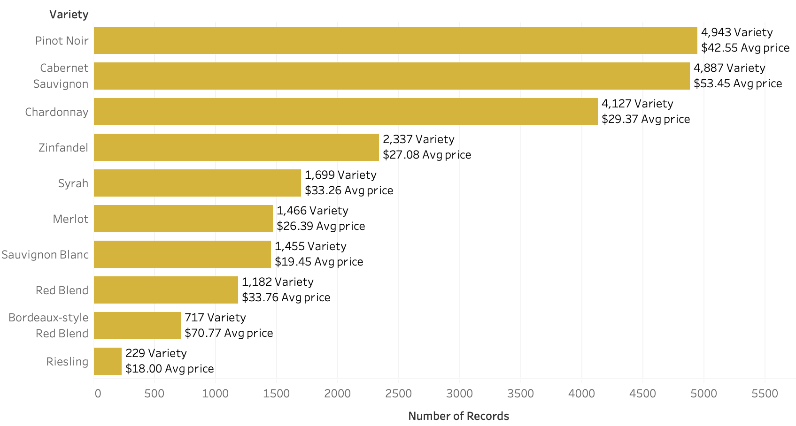
Top 10 California Varieties

Slide 7
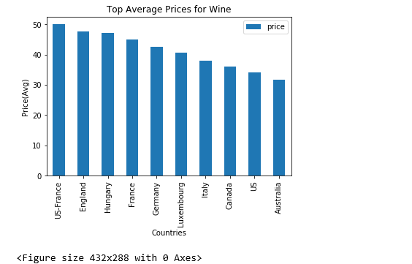
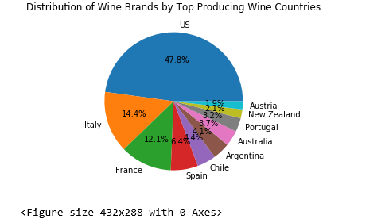
Fun Facts

Slide 8
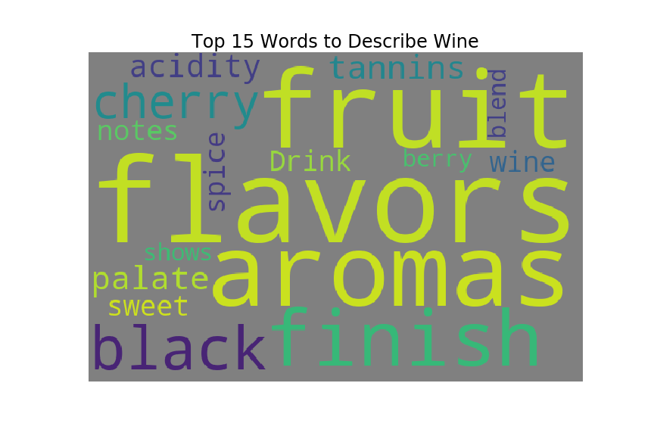
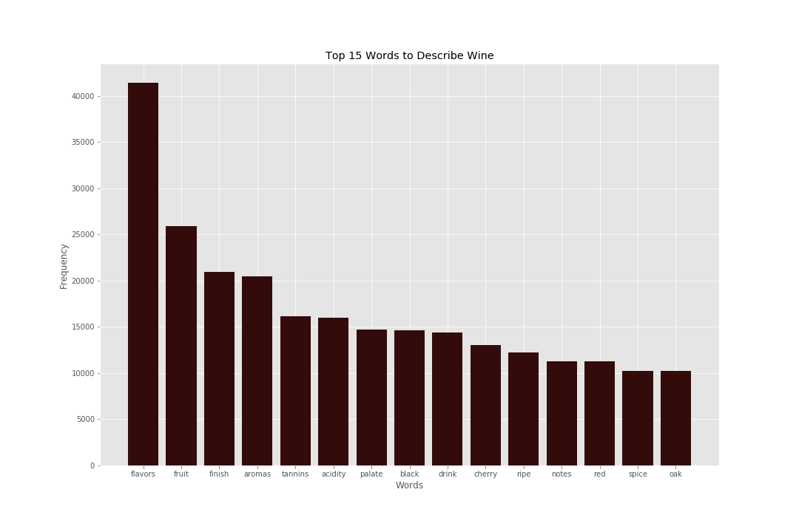
Fun Facts

Slide 9
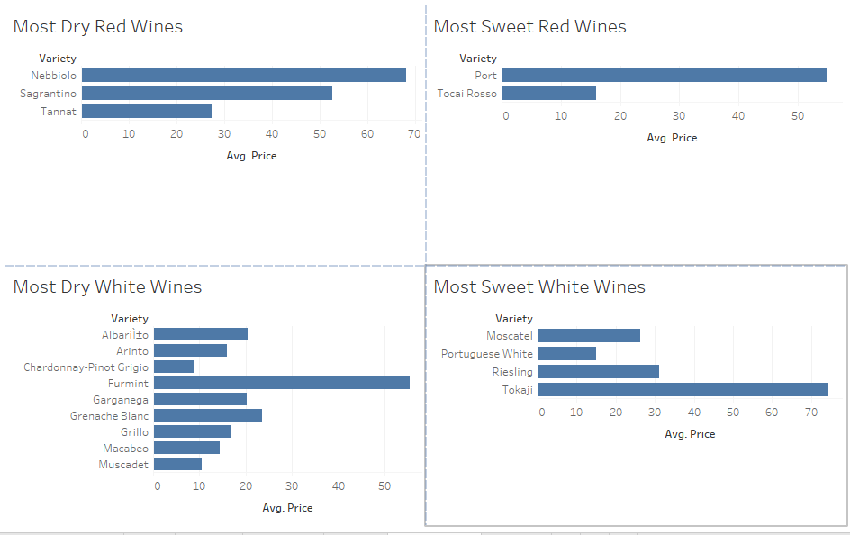
From Dry to Sweet

Slide 10
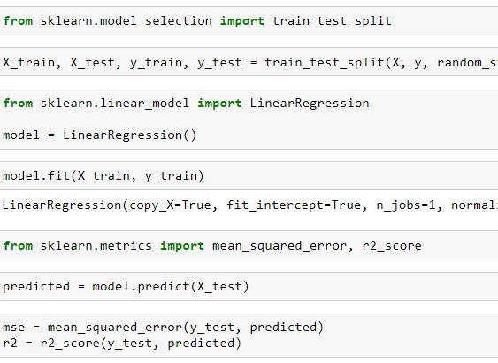
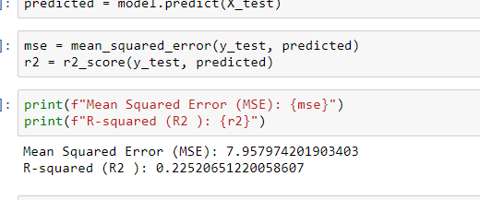
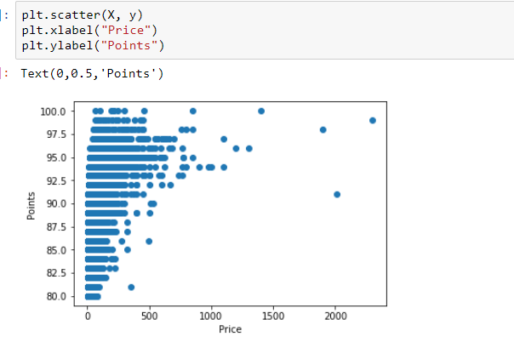
Correlation Between Points and Price

Slide 11
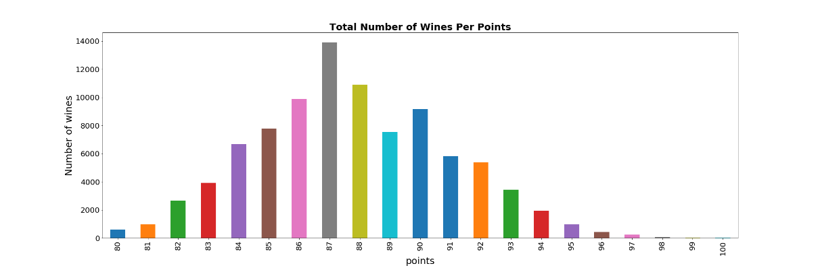
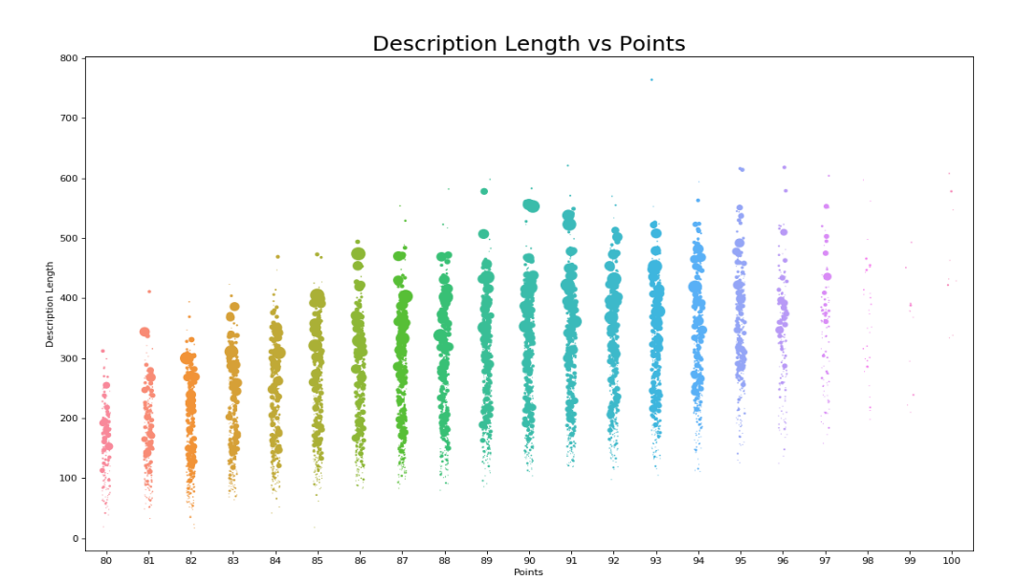
Rating Distribution

Slide 12
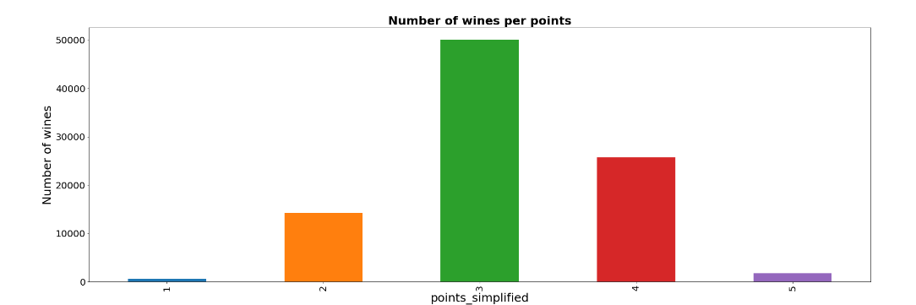
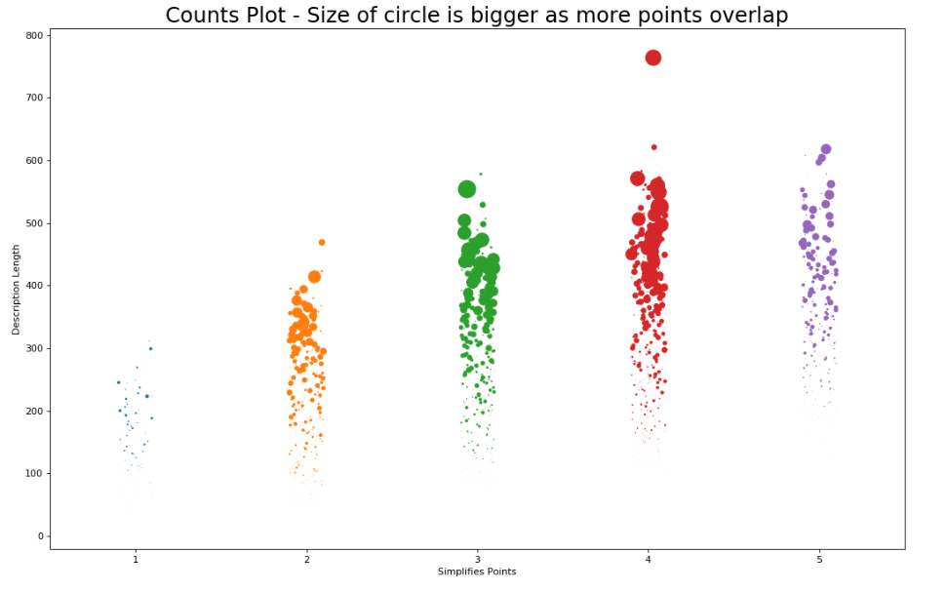
Rating Distribution (simplified)

Slide 13
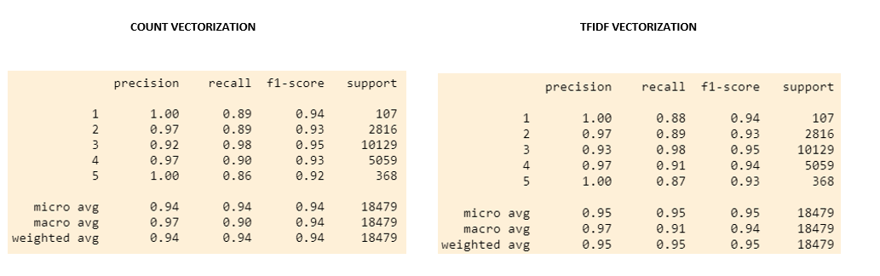
Vectorization w/ Training and Testing Results

Slide 14
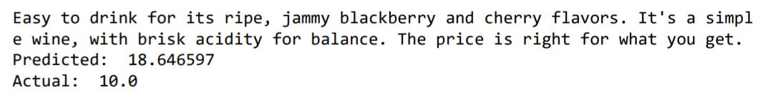
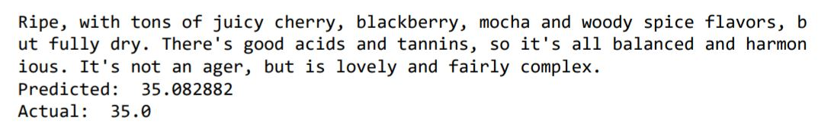
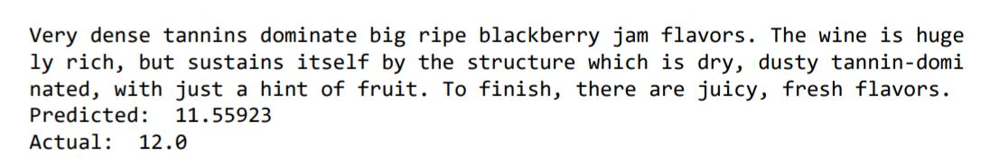
Is it possible to predict the price of a wine based on its description and variety?
Yes, it is possible.

Slide 15
Appendix
Slide # | Content
3,4,5,6 | Tableau
7 | Python Matplotlib
8 | Python Matplotlib
9 | Tableau
10 | Linear Regression
11-12 | Python Matplotlib
13 | Vectorization/Random Forest
14 | Pandas, Tensorflow, Tokenizer,

